Slide 1

SAP Analytics cloud training
Anubhav Oberoy
Day 14

Slide 2
Agenda – Day 14
Time Series
Notes:
Data Actions & Connections Basics
Data Actions in SAC
Introduction to Connections
Cloud Connector
Connecting to Import data with BW
Connecting to S/4HANA System
---Break---
Build CDS Views
Introduction to CDS View
Consume S/4HANA CDS views
Import data connection
Live Data connection with analytic Query

Slide 3







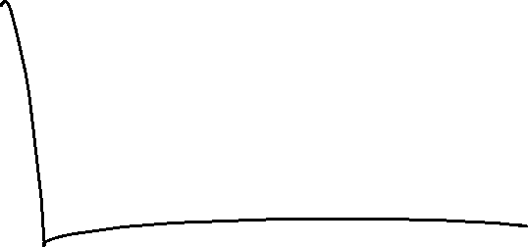



Time Series
If you want to predict values which are of nature continuous (number). Unlike regression, in the time series our goal is to predict the trend also. Which means multiple values which are function of time.
Time series will help
Multiple values which are factor of time
Output predicted based on a segment
One axis is always time
www.anubhavtrainings.com

Slide 4







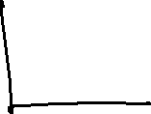














Expenditure and Revenue
www.anubhavtrainings.com

Slide 5
End of Day 14

Slide 6

Questions

Slide 7

Anubhav Oberoy
anubhav.abap@gmail.com

